Slide 1
RESEARCH FACILITATION TEAM
DIGITAL RESEARCH SERVICES SUPPORT AT ALL STAGES OF YOUR RESEARCH LIFECYCLE
07th August

Slide 2
PRESENTATION STRUCTURE
WHAT IS DIGITAL RESEARCH SERVICES?
RESEARCH FACILITATOR ROLE
WEBSITE
FUTURE EVENTS
Dr André Vieira
Research Facilitator, CSE

Slide 3
How can the DRS help?
We act as a focal point for all the data and computing services available to researchers at the UoE.
Dr André Vieira
Research Facilitator, CSE

Slide 4
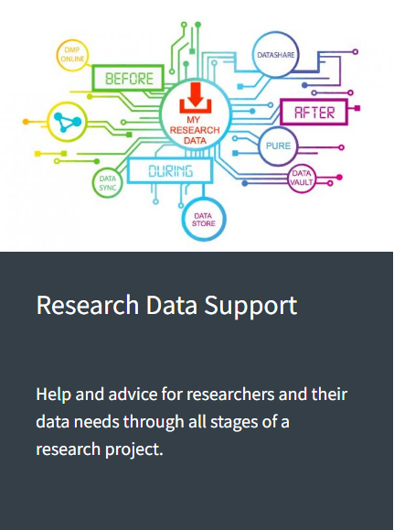
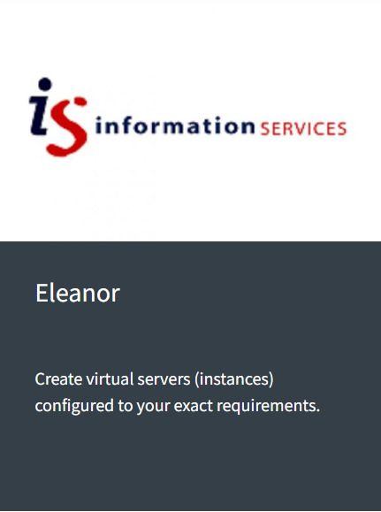
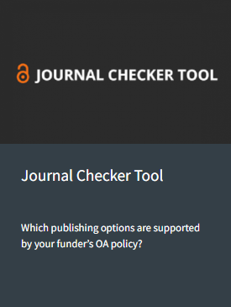
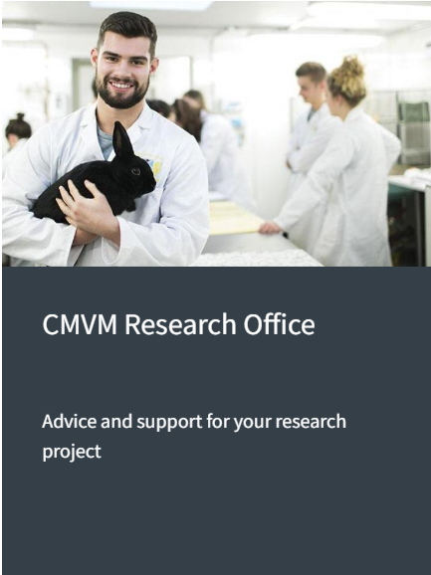
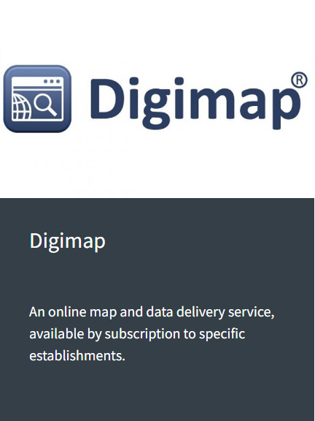
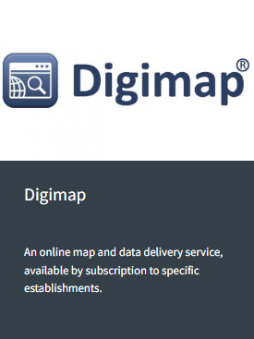

Slide 5
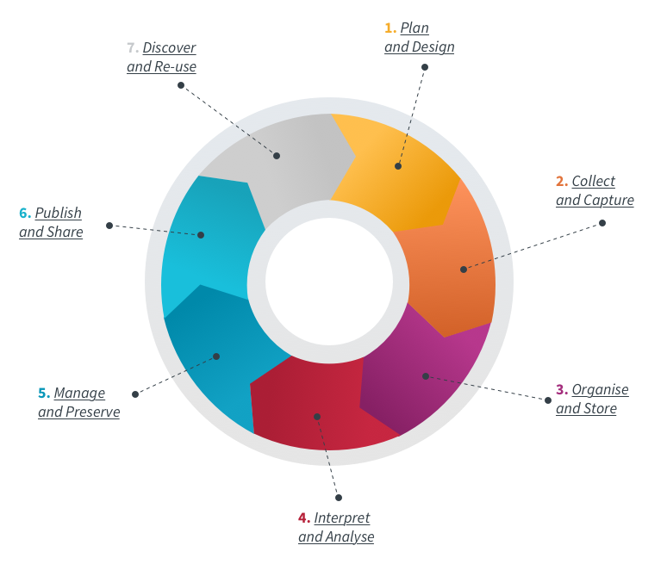
The DRS can help RESEARCHERS with:
RESEARCH PLANNING
Comply with best research practices
Meeting funder requirements
Developing digital skills
Becoming part of a research community
Updating on Digital resource usage
Sharing, publishing and promoting YOUR data and work – open research
Dr André Vieira
Research Facilitator, CSE

Slide 6
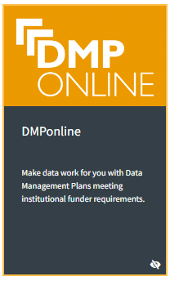
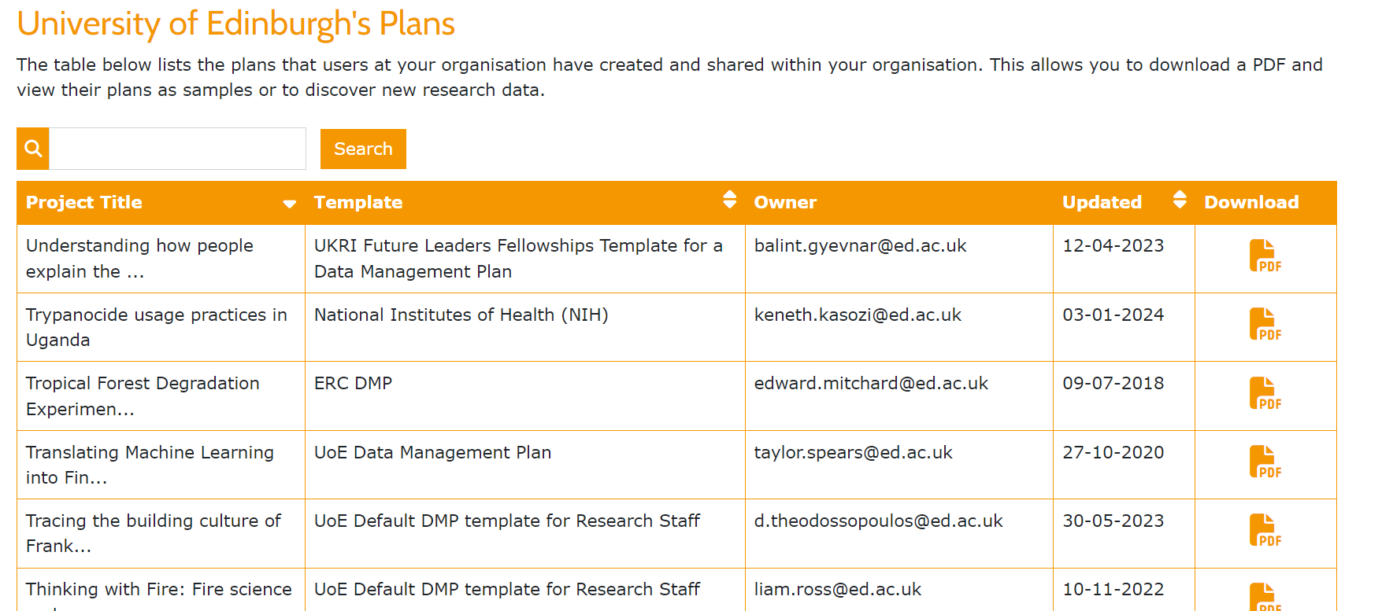
Dr André Vieira
Research Facilitator, CSE

Slide 7
Free 'at point of use' individual allocation of 500 GB for every researcher
Group spaces
Backed up to 3 different locations with offsite disaster recovery platform and offsite backup and retention
Restricted to University of Edinburgh computers
Support for very large data (>1 PB)
Connection between DataStore personal allocation or group space with DataSync
No Data encryption
Dr André Vieira
Research Facilitator, CSE

Slide 8
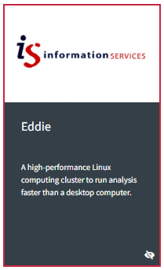
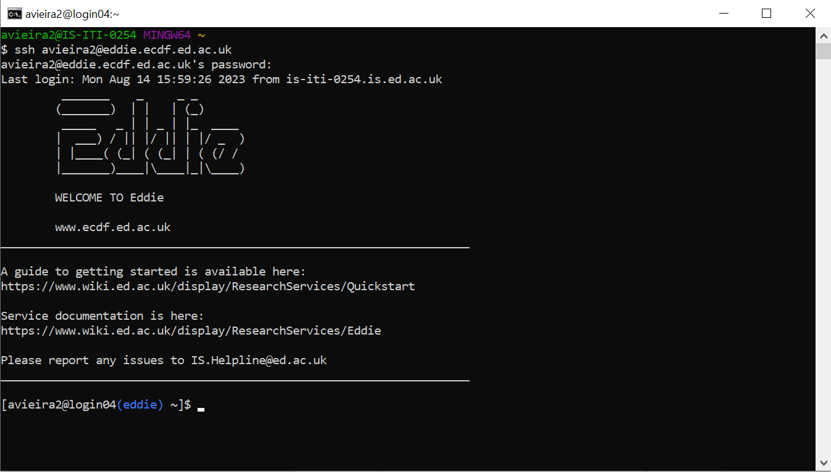
Dr André Vieira
Research Facilitator, CSE

Slide 9
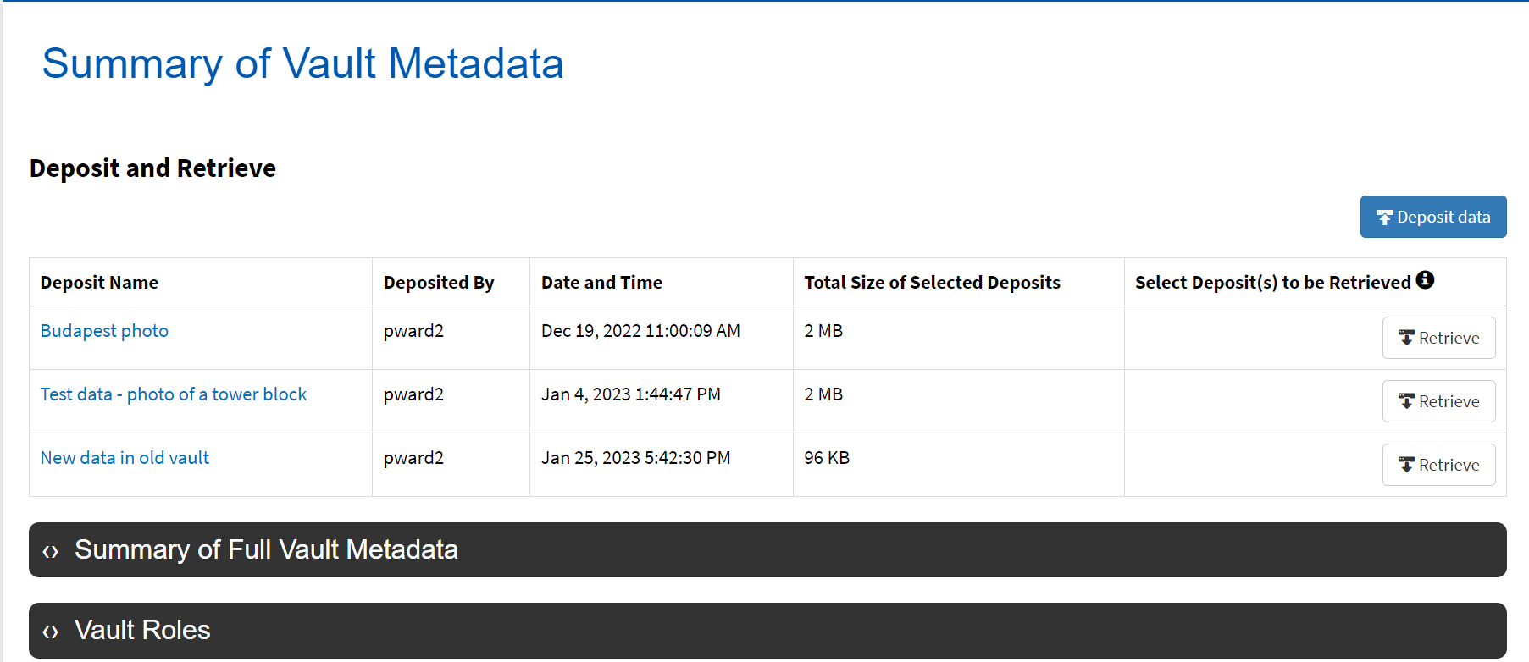
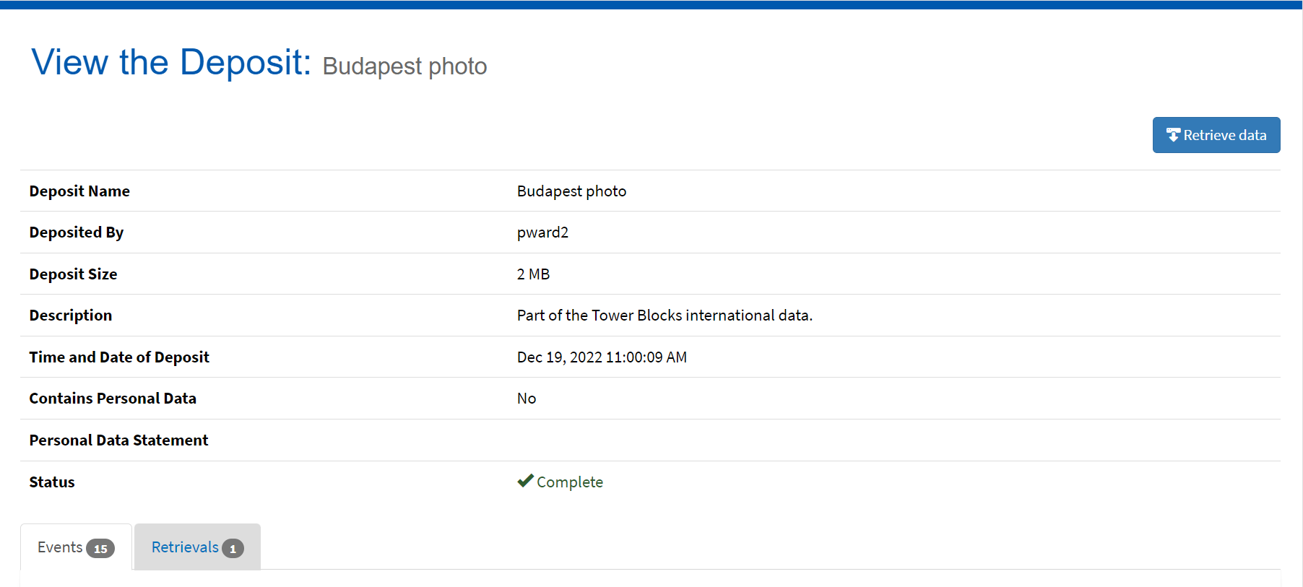
Dr André Vieira
Research Facilitator, CSE

Slide 10
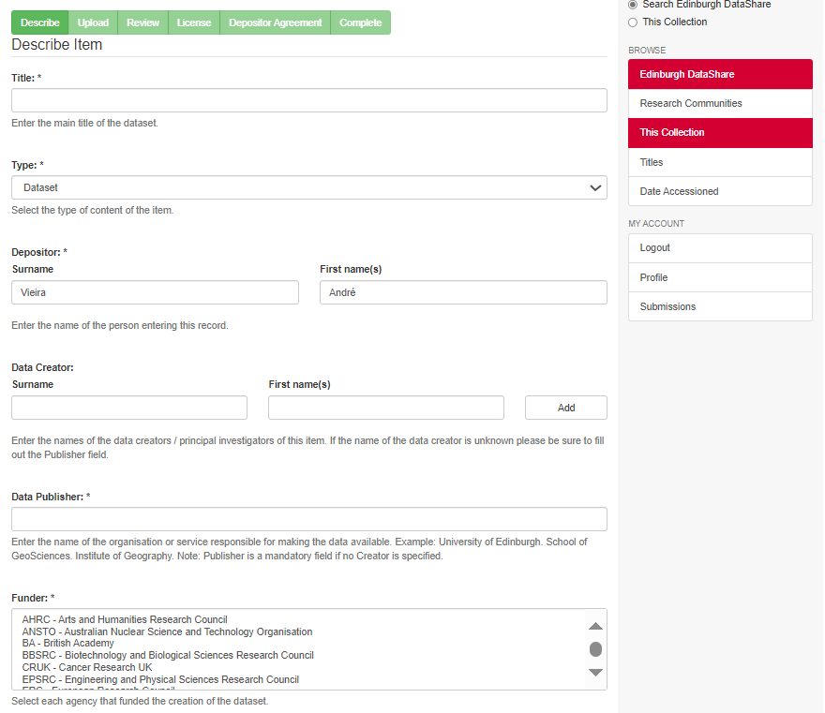
Dr André Vieira
Research Facilitator, CSE

Slide 11
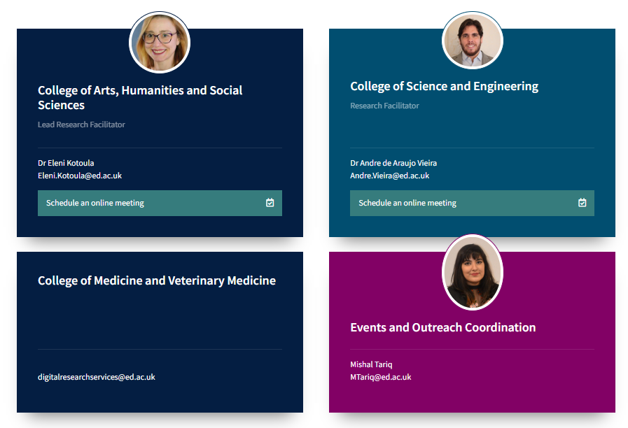
Help you navigate the complex landscape of digital tools
Connect researchers and service providers
Community Building & Networking
Tailored approach to the problem
Enhance the research with digital resources
Produce digital resource-related training material
Dr André Vieira
Research Facilitator, CSE

Slide 12
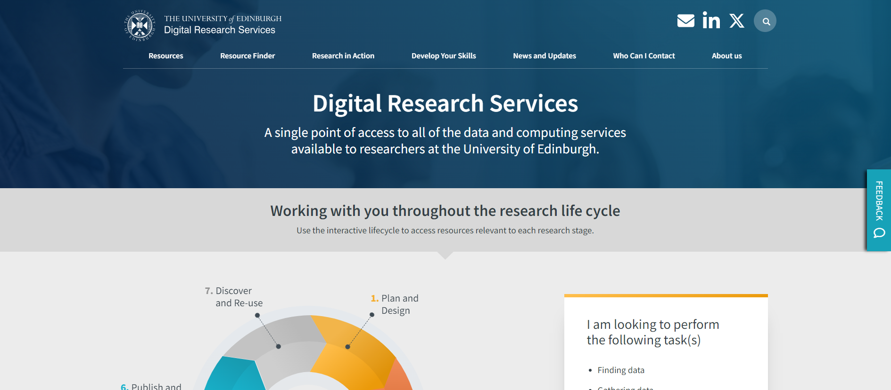

Slide 13
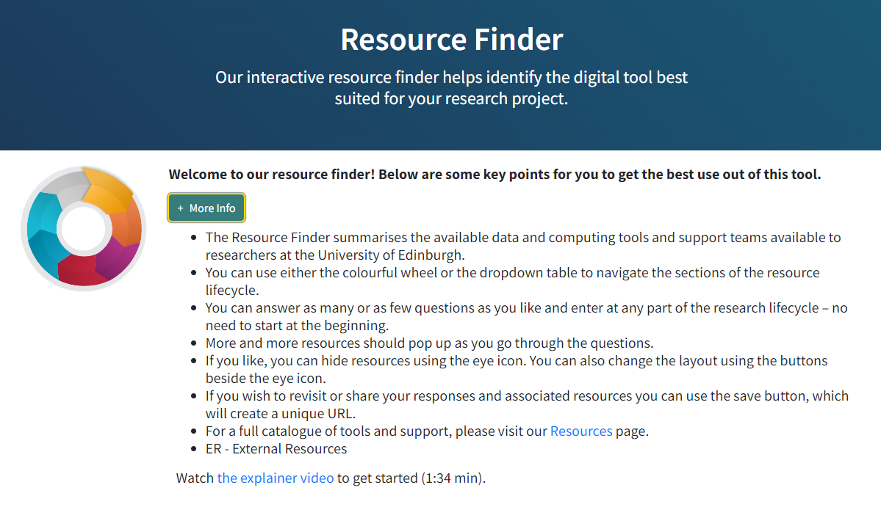
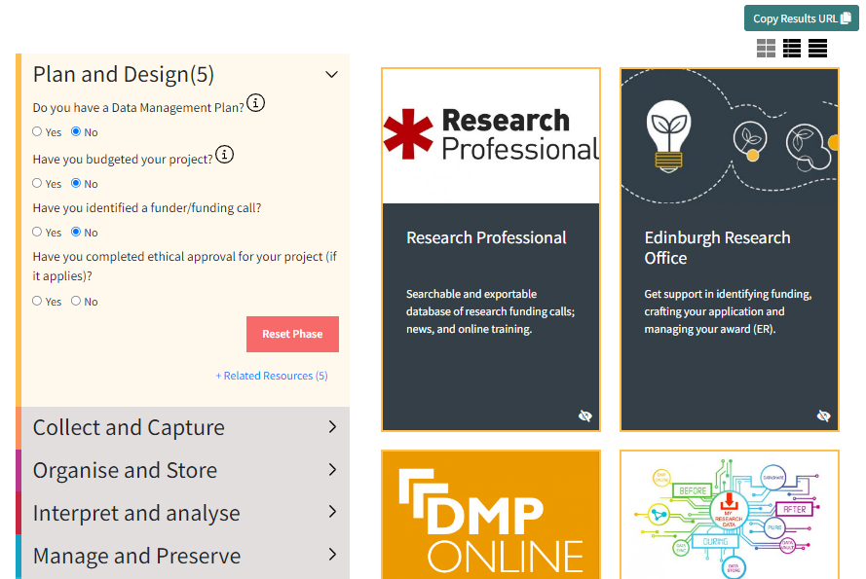
https://digitalresearchservices.ed.ac.uk/resource-finder

Slide 14
SEP
Welcome Week and Inductions
Multiple venues
SEP - NOV
Introduction to Digital Research Services
Future
Events
Online Webinars
02
OCT
2024DRS Ambassadors Celebration
Venue to be Confirmed
OCT - NOV
HPC in Focus
Multiple Venues at King’s Buildings
OCT - NOV
Spotlight Webinars on Research Planning
Online via MS Teams
Dr André Vieira
Research Facilitator, CSE

Slide 17
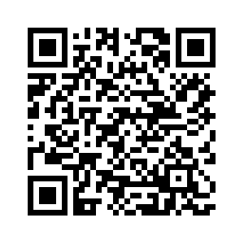
USEFUL LINKS
https://mlist.is.ed.ac.uk/lists/subscribe/digitalresearch
https://uoe.sharepoint.com/sites/DRSFacilitation
https://www.digitalresearchservices.ed.ac.uk/
https://www.linkedin.com/company/DRS_UoE
https://twitter.com/DRS_UoE
digitalresearchservices@ed.ac.uk
SUBSCRIBE TO OUR MAILING LIST

