Slide 1
RSEs and Resources at EPCC
CERSE 31/05/23

Slide 2
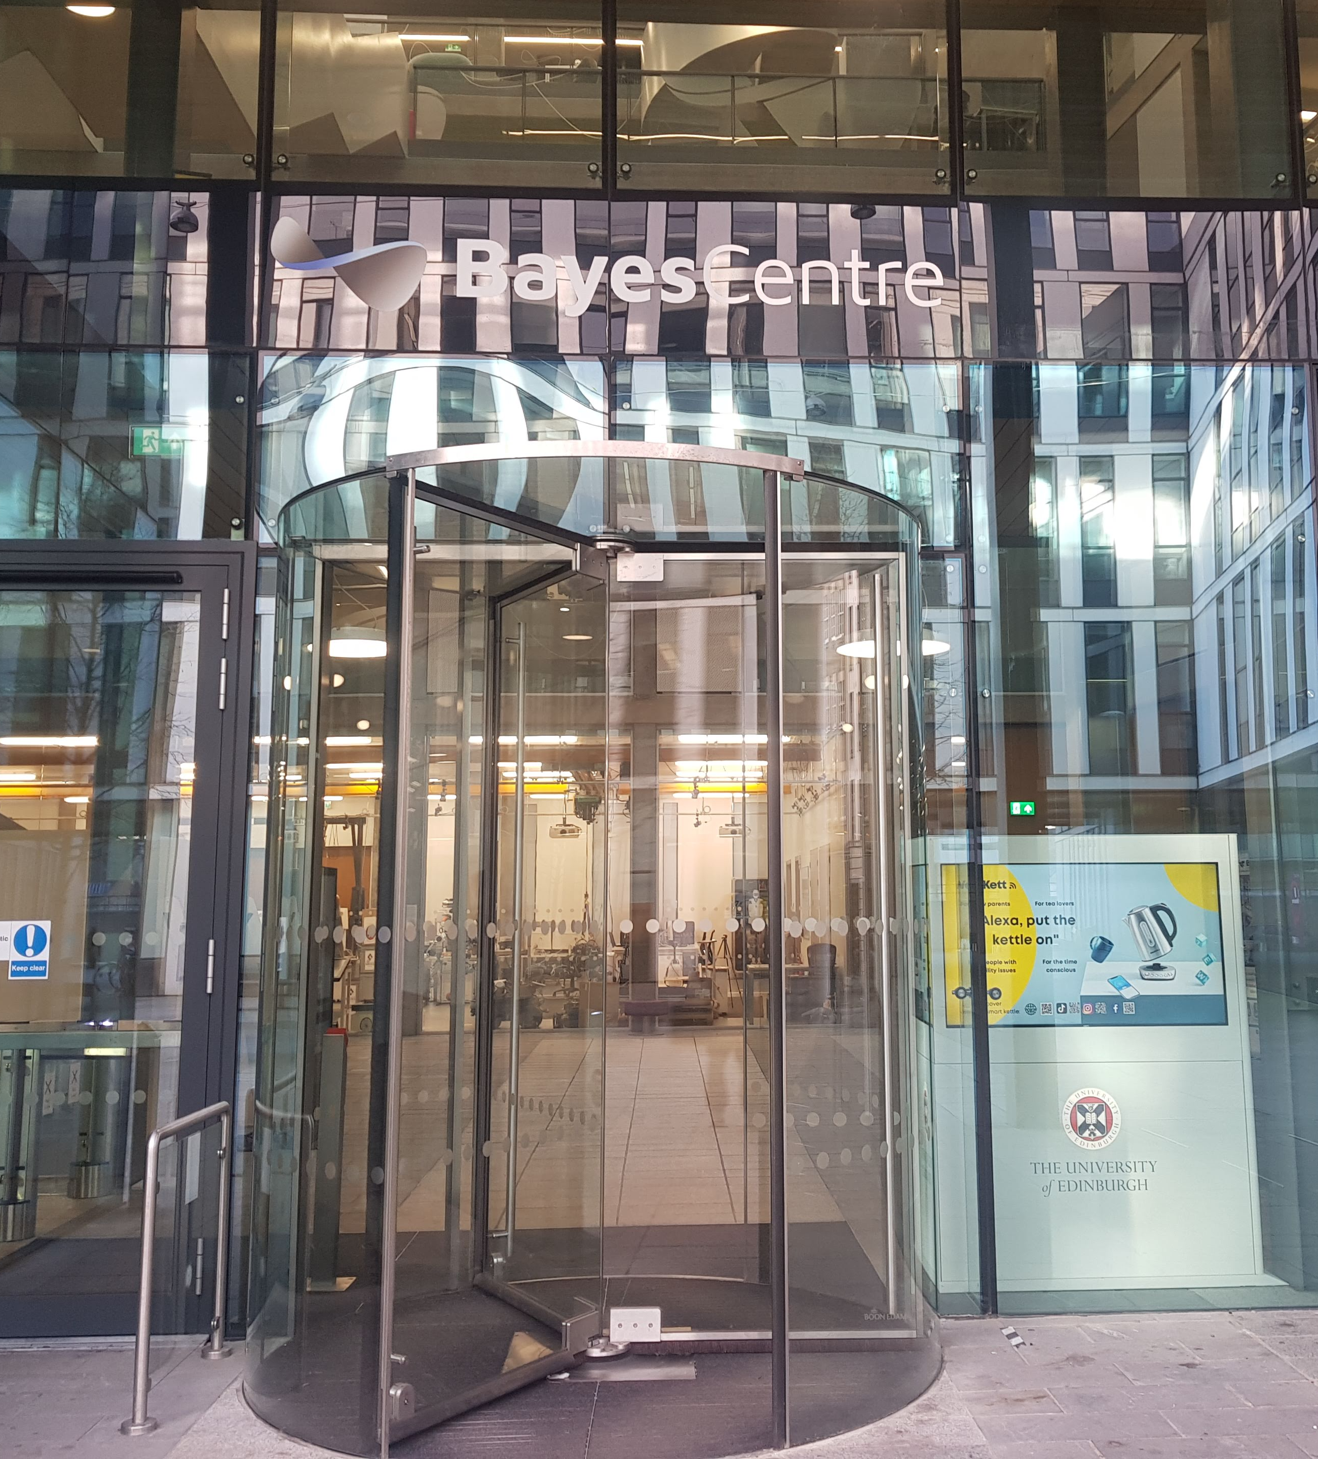
A bit of history
Established in 1990
Department of Physics at UoE used parallel computers for a number of research projects
QCD, Solid State Physics, …
EPCC was established as an independent institute to:
Promote the use of parallel computers in academia and industry
To be self funded
Edinburgh Parallel Computing Centre – now just EPCC
Originally based in the JCMB at the Kings Buildings
Moved to the Bayes Centre when the building first opened in 2018
Occupy most of the second floor at the Bayes
For a long time EPCC was composed of around 40-50 individuals
Now have around 130 individuals
Have almost run out of space on the second floor

Slide 3
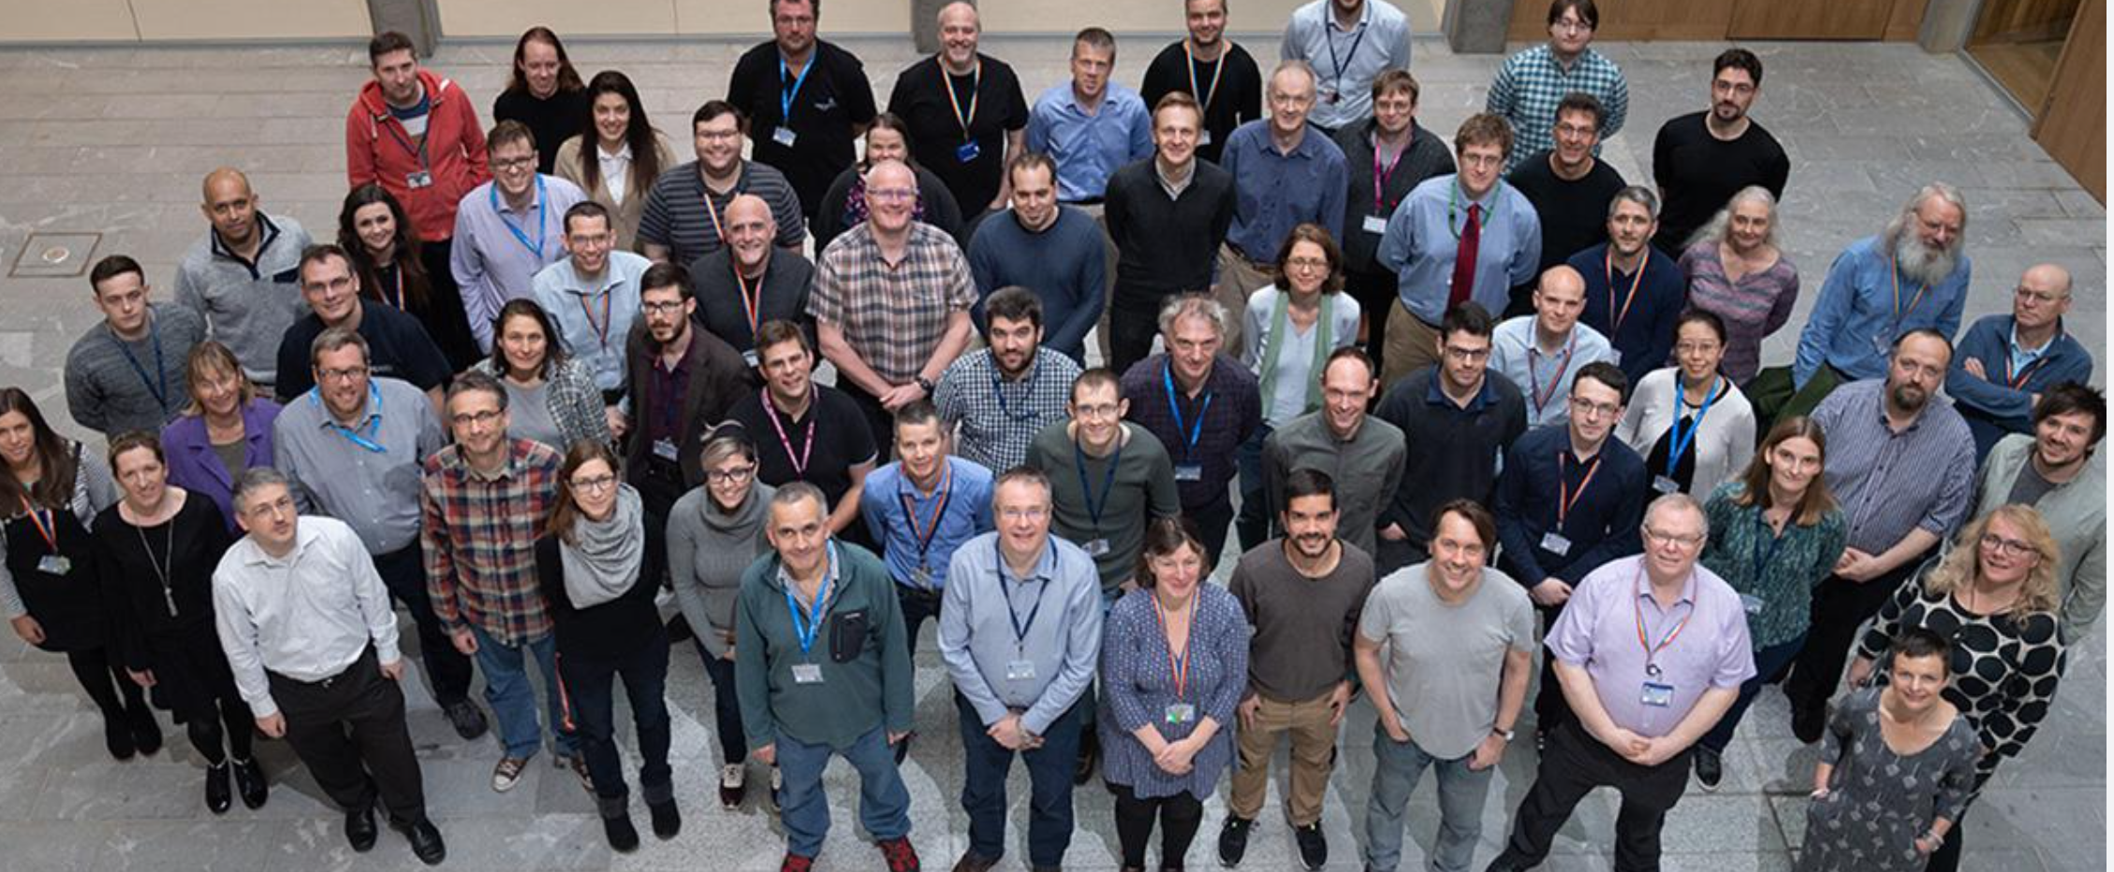
A good place to work …
A bright multi disciplinary (mostly) young set of people to work with
Aka a bunch of high powered geeks…
A half-way house between industry and academia and industry
A little more regimented than an academic post but not as draconian as industry
Some novel and big kit to play with (more on this later)
Run MSc/PhDs
MSc in High Performance Computing (HPC) and HPC with Data Science
Always looking for interesting MSc projects
Mostly project based work
Challenge and extend your skill set
Software Sustainability Institute (SSI) based at EPCC (more on this later)

Slide 4
Big kit
ARCHER2 – UK's National Supercomputing Service (Tier-1 system)
5,860 nodes: 5,276 standard memory (256GiB), 584 high memory (512GiB)
Node: 2× AMD EPYCTM 7742, 2.25 GHz, 64-core
More info: https://www.archer2.ac.uk/
Cirrus – EPSRC Tier-2 National HPC Facility
280 compute nodes (2.1 GHz, 18-core Intel Xeon E5-2695 (Broadwell) with 256GiB mem)
2 compute nodes (384GiB mem) each with 4 GPUs
36 compute nodes each with 4 GPUs (NVIDIA v100 GPUs 16GiB)
More info: https://www.cirrus.ac.uk/
EIDF (Edinburgh International Data Facility)
Data Science Cloud
More info: https://www.ed.ac.uk/edinburgh-international-data-facility

Slide 5
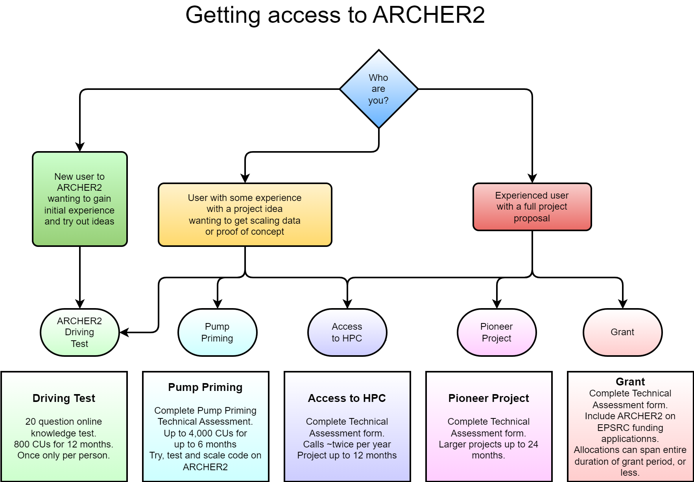
Access to ARCHER2
Thanks to Clair Barrass

Slide 6
Access to Cirrus
On the Cirrus web: Access > Scottish Academic Access
Possibly most pertinent - Scottish Academic Scheme
Trial access
Max ~15k CPU-h 600 GPU-h
Production access
Max 1M CPU-h 40k GPU-h
Have to fill in an application:
Only one Scottish Access application will be funded per researcher
There are other methods of access …

Slide 7
Software Sustainability Institute (SSI)
Virtual Organisation consisting of
Edinburgh, Manchester, Southampton and Oxford
Started in 2010
Director, Prof Neil Chue Hong, based at EPCC
Generally advocates: better software, better research
Large number of activities
Started the RSE movement – now has a life of its own
Encouraged the adoption of the Carpentries in the UK
Edinburgh Carpentries (EdCarp) sister effort to CERSE
Runs a Fellowship Programme
…
More info: http://www.software.ac.uk/

Slide 8
Conclusions
EPCC a great place to work for/with
Can use it as a resource:
Hardware/Storage that is available
The people involved
Engage with the SSI

Slide 9
Proposal: Run monthly virtual meetings that “tour” around Institutions in Scotland that have RSEs. Feel free to volunteer to host an event. Aim to run one in-person event a year.
Join the mailing list:
https://jiscmail.ac.uk/cgi-bin/wa-jisc.exe?SUBED1=SCOTRSE&A=1
Come along to the launch event:
https://www.eventbrite.co.uk/e/scotrse-launch-event-tickets-645289758037
Any questions? Please get in touch: k.pringle@epcc.ed.ac.uk
Or through the Scotland channel on UKRSE Slack
Launch event :
Wednesday 14th June 10-11 am
Intro meeting will be an informal chat to focus on community building and get to know each other.
Notes:
Register here: https://www.eventbrite.co.uk/e/scotrse-launch-event-tickets-645289758037
Mailing list : https://jiscmail.ac.uk/cgi-bin/wa-jisc.exe?SUBED1=SCOTRSE&A=1

