Slide 1
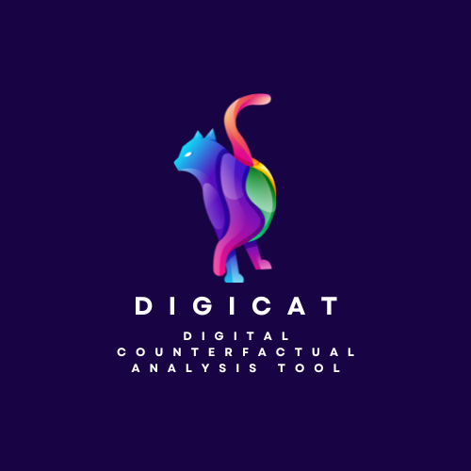
Developing a digital counterfactual analysis tool (DigiCAT)
to identify active ingredients in mental health
Aja Murray, Reader in Psychology, School of PPLS: aja.murray@ed.ac.uk

Slide 2
The Wellcome Trust Data Prize
Funds digital tools for mental health research
Three stages:
Discovery Phase (11 teams)
Prototyping Phase (5 teams) ← we are here
Scaling up Phase (3 teams)

Slide 3
Why a counterfactual analysis tool?
Substantial value in using observational (pre-existing) data
Challenging to identify active ingredients observational data, e.g.:
Counterfactual analysis can help
SES, previous mental health etc.

Slide 4
Prototyping phase
Develop a digital tool prototype to make counterfactual analysis more accessible to mental health field
Address under-utilisation in mental health research:
Technically complex, lack of familiarity & training, lack of accessible tools
Existing tools/packages have important limitations e.g.:
Missing data
Non-binary active ingredients
Complex survey data

Slide 5
Tool goals
Promote knowledge, uptake, and principled use of counterfactual analysis in mental health research:
Test active ingredients to inform treatment development
Get more value out of existing data
Reduce resources wasted on active ingredients that don’t have a genuine effect on mental health

Slide 6
Our approach to tool development
Provide easy point & click interface accompanied by tutorials & guidance
R for backend, Shiny for frontend
Informed by diverse user consultations AND lived experience expert input
Embed Findable Accessible Interoperable Reusable principles
Code/materials available, clearly commented/documented etc.

Slide 7
How lived experience experts will inform the tool
Young person advisory group advising on priority uses of the tool:
Key priority include:
social media
sleep
academic stress
relationships (with peers, parents, teachers)
Next steps:
Expand advisory group to including young people from lower-middle and low income countries
Advisory group of professional experts by experience

Slide 8
User consultation process
Large-scale survey:
Global recruitment
Identify target audience / likely users, their needs & goals/motivations
Advisory group discussions:
Identify which features are most needed
Provide feedback on prototype to inform refinement of final version
Notes:
Content to add:
Large-scale survey to identify target audience / likely users, their needs, and their goals/motivations
Global recruitment
Also serves a pilot for dissemination (i.e., channels that bring in survey responses are also likely to be good channels for disseminating the tool once it is ready)
Advisory group discussions to
(1) identify which features are most needed (e.g., full workflow vs focused tool; data security; computational demands; transparency; output formats), what kinds of tutorial/documentation information and formats are most useful
(2) provide feedback on prototype to inform refinement of final version

Slide 9
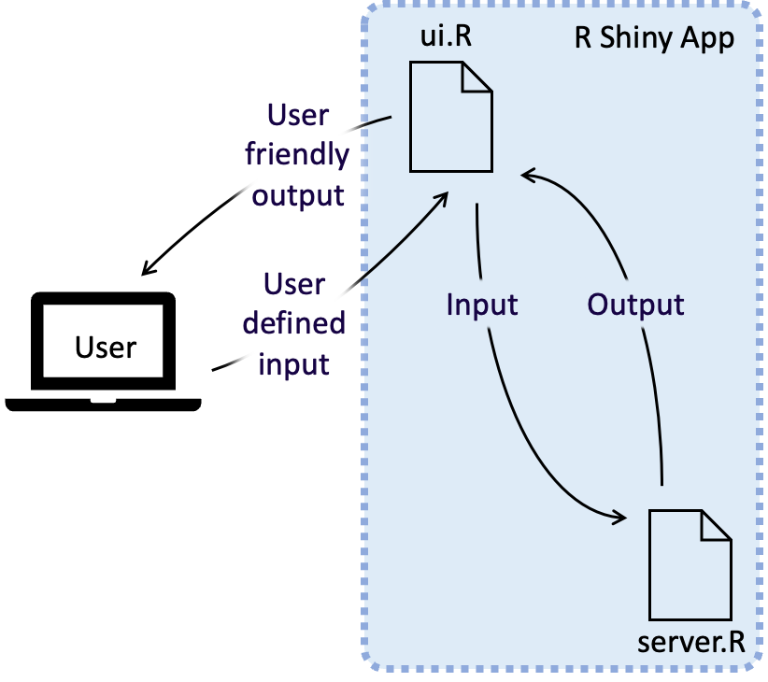
Current tool design
Our tool is an R Shiny app which is comprised of a user interface object (ui.R), which controls the layout and appearance of the app, and a server function, which transforms user input into the desired app output.
Our app will be hosted as a web application:
Will be able to support multiple users at the same time
Will make tool more assessable (no set up required) without sacrificing methodology or transparency
Notes:
User map/demo at it stands at point of presentations goes here
Our app has been created using R Shiny – an open source R package for app development.
The user interface of the app is determined by a user interface (ui.R) object which determines the app’s appearance and layout. When a user interacts with the app, this information is passed to a server function (server.R) which processed it and produced output, which is then relayed back to the user interface and displayed to the user.

Slide 10
The tool
Notes:
https://digicatapp.shinyapps.io/DigiCAT_demo/

Slide 11
Challenges
How we sustain the tool in the long-term?
How can we ensure good use of the tool?

