Slide 1
Kao group and COVID – lessons learned
Dr Anthony Wood
CERSE Meeting, Roslin Institute
31 May 2023

Slide 2
Me
2011 - 2015 MSci Theoretical Physics (Nottingham)
2015 - 2019 PhD Theoretical Physics (Edinburgh)
Nonequilibrium statistical mechanics
Mathematica, MATLAB, pen and paper
Learned: how to go about solving a problem
2019 - 2021 Industry (fintech)
Automating reconciliation of trading data from different sources (traders, banks, Bloomberg etc)
SQL, Excel
Learned: how to deal with high-freq/high-volume/messy/“real” data
2021 - Postdoc @ Roslin, Kao group
Applying data science to understand patterns in infectious diseases
R
Learned: how to pull insightful things from data

Slide 3
Kao group
Models of infectious disease transmission (often informed by “big” data)
Networks
Derived from populations, trading patterns, sewers, commutes, Twitter…
Genetic sequences
Comparing samples to infer who-infected whom
Mix of vets, mathematicians, physicists, software engineers, computer scientists
Present
Rowland Kao
Anthony Wood
Tijani Sulaimon
Anna Gamza
⭐️ Chris Banks
Ewan Colman
⭐️ Aeron Sanchez
Muhammad Bilal
⭐️ Software Engineers
Past
Paul Bessell
Anne-Sophie Ruget
⭐️ Tom Doherty
Sam Lycett
Gianluigi Rossi
Jess Enright
Gavrila Puspitarani
Collaborators
Anne Marie MacKintosh
Martine Stead
Current diseases
Rift Valley fever
Avian influenza
Bovine viral diarrhoea
“Rumours and behaviour”
Bovine TB
COVID-19

Slide 4
What happened in COVID-19?

Slide 5
Kao group
Early access to detailed data
Experience in disease modelling

Slide 6
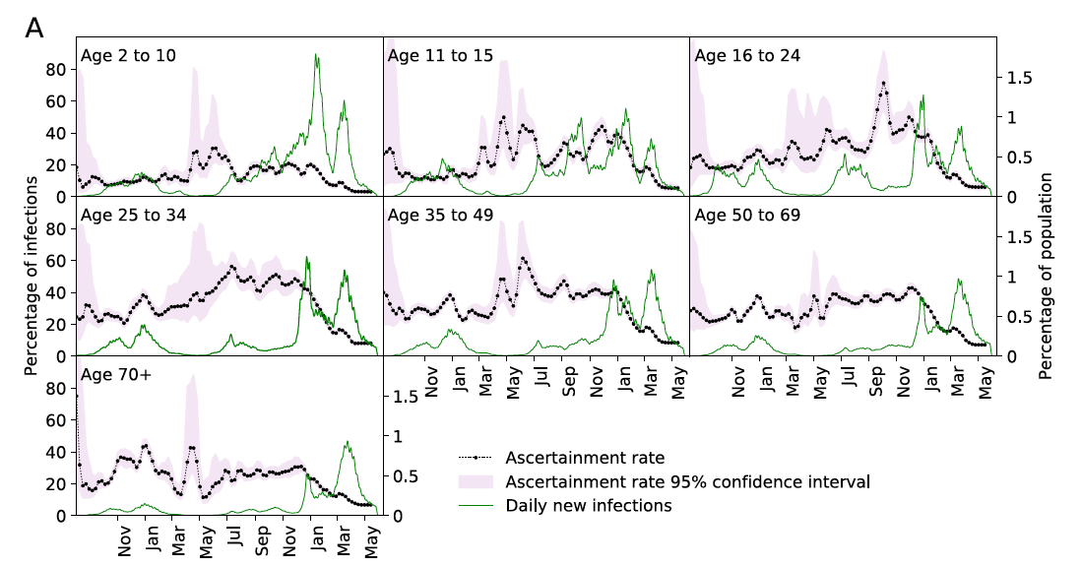
Kao group
Early access to detailed data
Experience in disease modelling
Colman et al. 2023
Journal of Theoretical Biology
https://doi.org/10.1016/j.jtbi.2022.111333
Modelling case ascertainment
Estimating true number of infections as opposed to cases

Slide 7
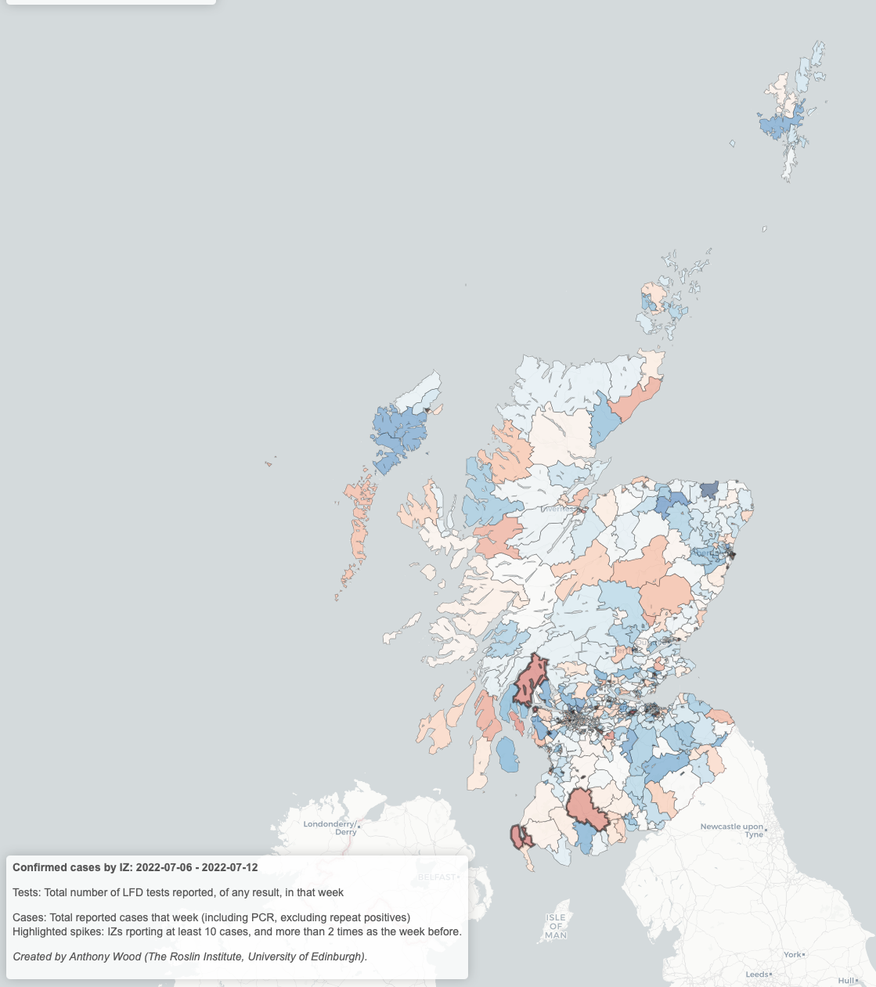
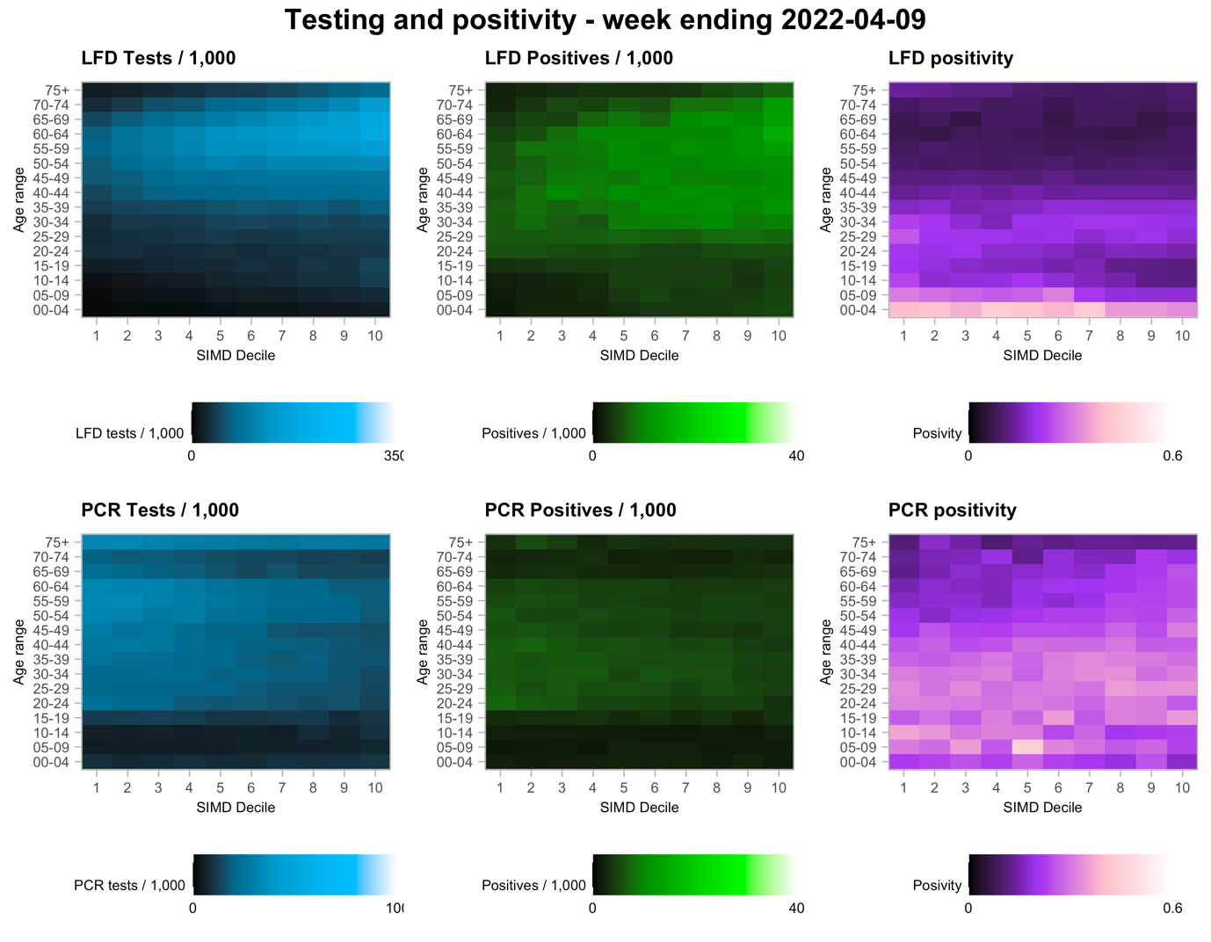
Kao group
Early access to detailed data
Experience in disease modelling
Wood et al. 2022
Medrxiv preprint
https://doi.org/10.1101/2022.08.03.22278013
Modelling case ascertainment
Estimating true number of infections as opposed to cases
Real-time analysis of COVID-19 outcomes
Emphasis on variation with socioeconomic deprivation

Slide 8
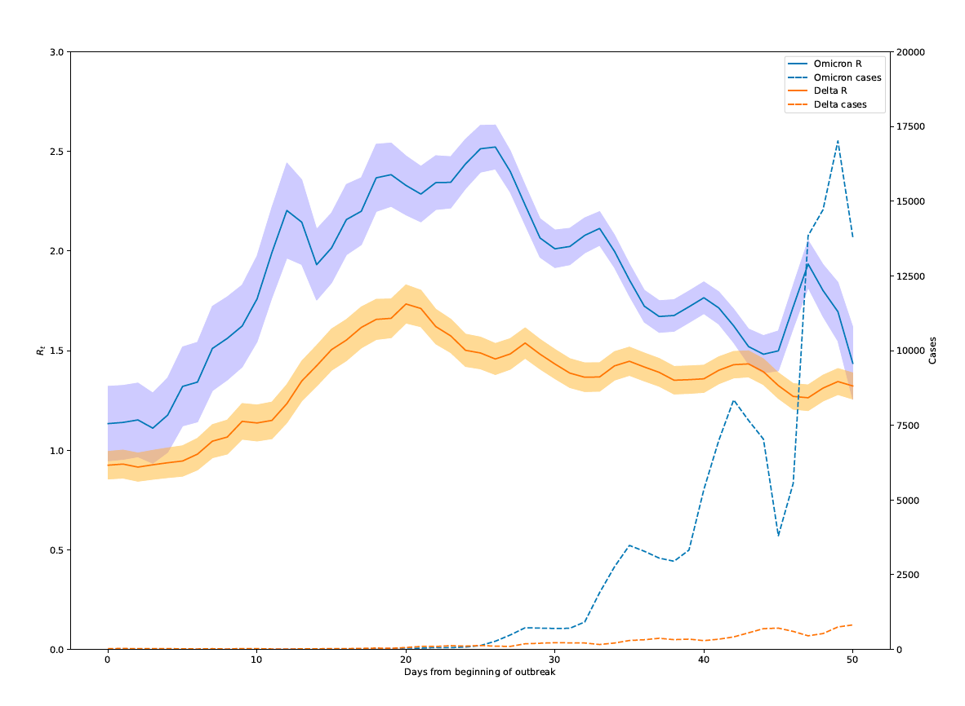
Kao group
Early access to detailed data
Experience in disease modelling
Modelling case ascertainment
Estimating true number of infections as opposed to cases
R-value estimates
Using existing case numbers to estimate past + present R-value locally
Chris Banks, Aeron Sanchez
Real-time analysis of COVID-19 outcomes
Emphasis on variation with socioeconomic deprivation

Slide 9
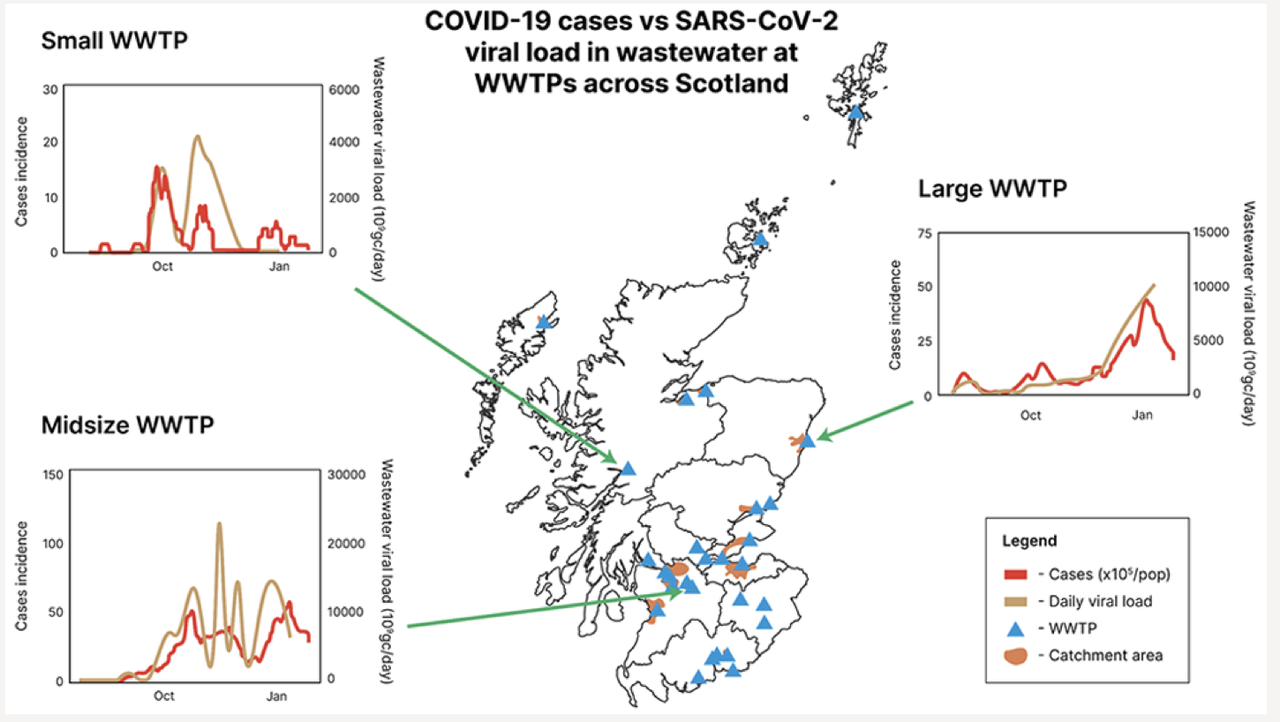
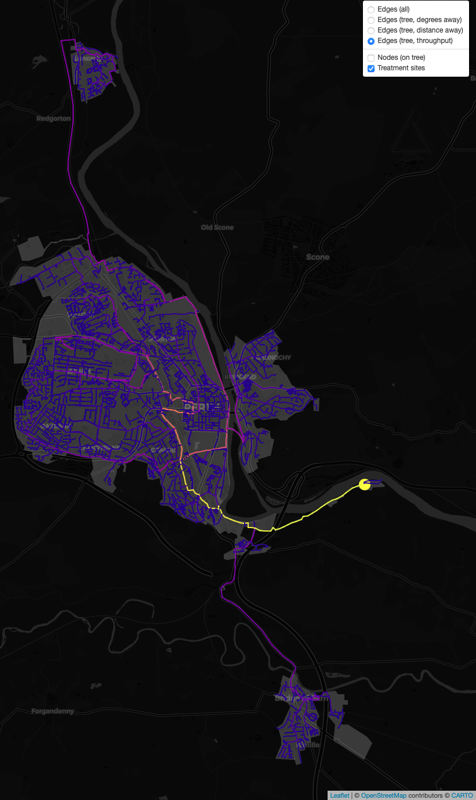
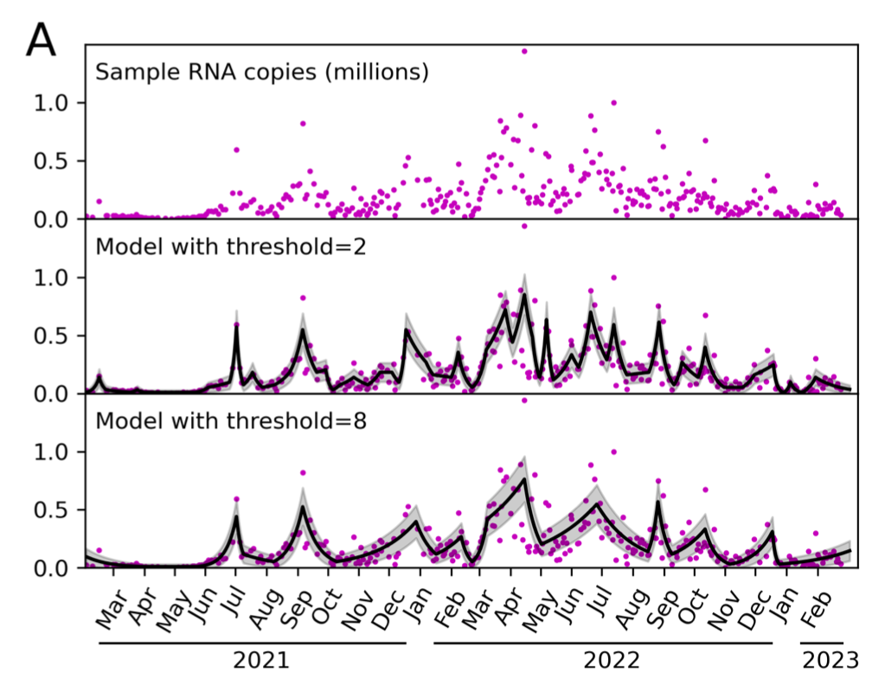
Kao group
Early access to detailed data
Experience in disease modelling
Fitzgerald, Rossi et al
Environmental Science & Technology
https://doi.org/10.1021/acs.est.1c05029
Modelling case ascertainment
Estimating true number of infections as opposed to cases
R-value estimates
Using existing case numbers to estimate past + present R-value locally
Colman, Kao 2022
Medrxiv preprint
https://doi.org/10.1101/2023.03.07.23286904
Real-time analysis of COVID-19 outcomes
Emphasis on variation with socioeconomic deprivation
Models of wastewater shedding
Prevalence vs shedding concentration
Optimal monitoring strategies with limited budget
Anthony Wood, Jess Enright, Rowland Kao
Ongoing work

Slide 10
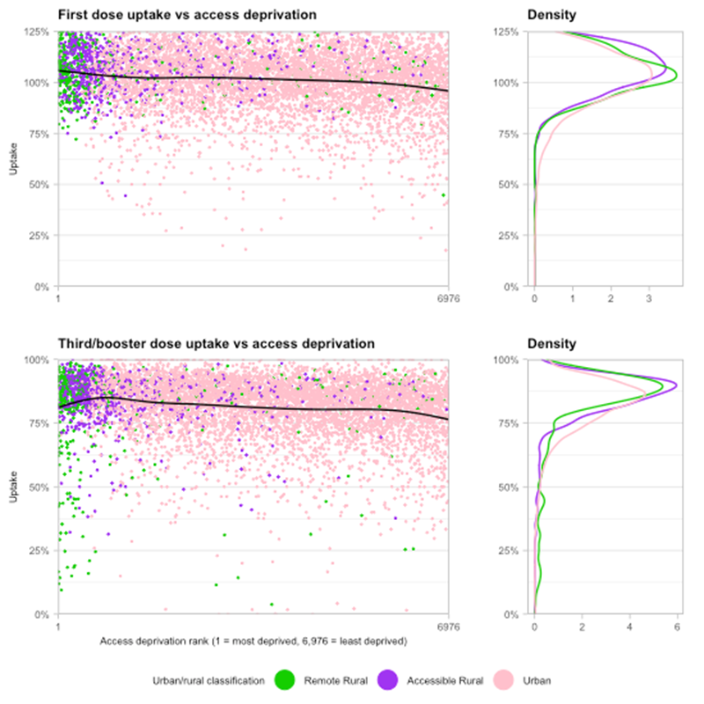
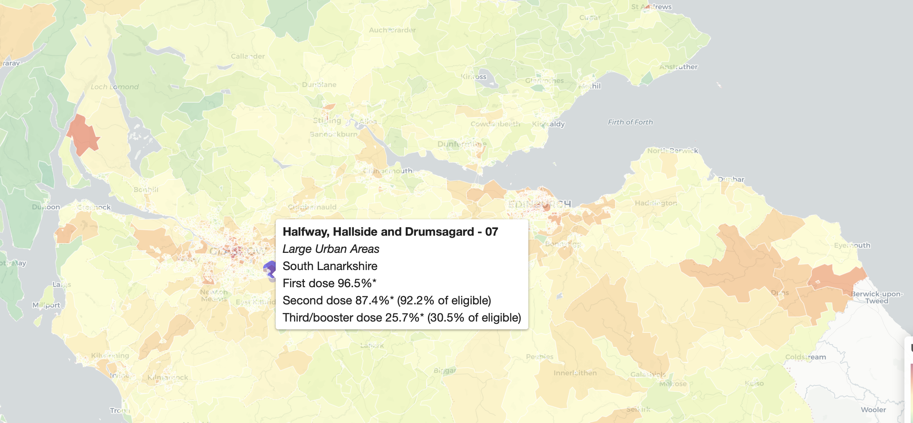
Kao group
Early access to detailed data
Experience in disease modelling
Anthony Wood
Modelling case ascertainment
Estimating true number of infections as opposed to cases
R-value estimates
Using existing case numbers to estimate past + present R-value locally
Real-time analysis of COVID-19 outcomes
Emphasis on variation with socioeconomic deprivation
Real-time monitoring of vaccine uptake
Highlighting regions of “low uptake” (hesitancy) and “slow uptake” (logistics)
Anna Gamza (in prep.)
Models of wastewater shedding
Prevalence vs shedding concentration
Optimal monitoring strategies with limited budget

Slide 11
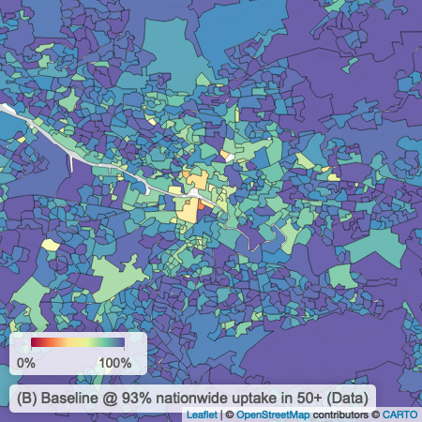
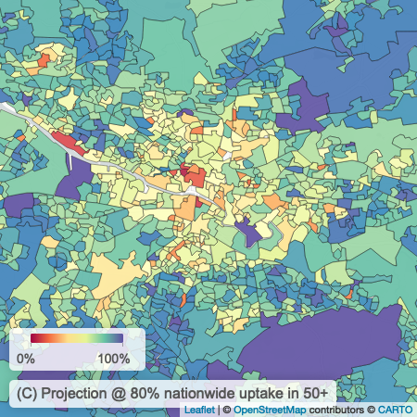
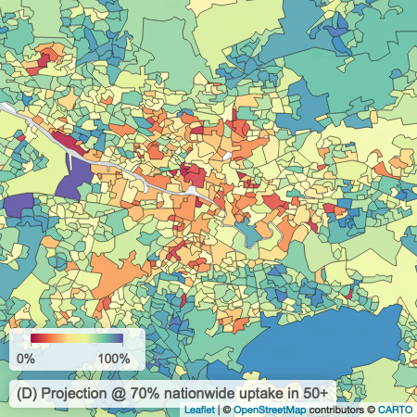
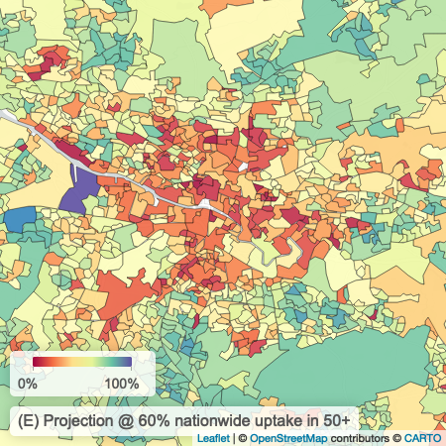
Kao group
Early access to detailed data
Experience in disease modelling
Wood et al.
Medrxiv preprint
https://doi.org/10.1101/2022.08.30.22279415
Modelling case ascertainment
Estimating true number of infections as opposed to cases
R-value estimates
Using existing case numbers to estimate past + present R-value locally
Real-time analysis of COVID-19 outcomes
Emphasis on variation with socioeconomic deprivation
Real-time monitoring of vaccine uptake
Highlighting regions of “low uptake” (hesitancy) and “slow uptake” (logistics)
Models of wastewater shedding
Prevalence vs shedding concentration
Optimal monitoring strategies with limited budget
Predictive models of future vaccine uptake
Predicting variation in uptake “fall-off” with future boosters
Predicted vaccine uptake in Central Glasgow

Slide 12
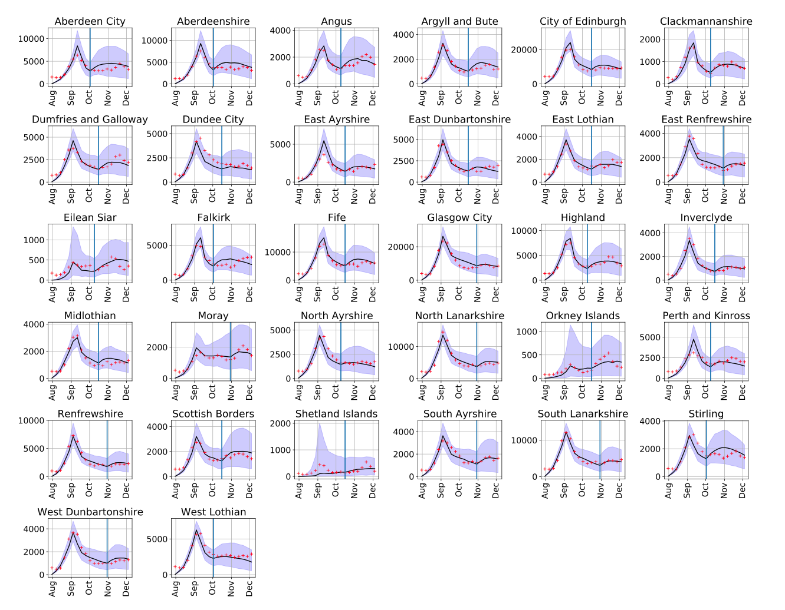
Kao group
Early access to detailed data
Experience in disease modelling
SCoVMod: Scotland’s Coronavirus Model
Individual-level model of disease spread across Scotland
Forecasts under different restrictions
Cattle disease model, rapidly adapted (early 2020) to COVID/humans by RSE
Test driven development
Paired programming
Banks et al. 2022
Wellcome Open Research
https://doi.org/10.21956%2Fwellcomeopenres.19604.r50789
Banks et al. 2022
arXiv preprint
https://doi.org/10.48550/arXiv.2211.13704
Modelling case ascertainment
Estimating true number of infections as opposed to cases
R-value estimates
Using existing case numbers to estimate past + present R-value locally
Real-time analysis of COVID-19 outcomes
Emphasis on variation with socioeconomic deprivation
Real-time monitoring of vaccine uptake
Highlighting regions of “low uptake” (hesitancy) and “slow uptake” (logistics)
Models of wastewater shedding
Prevalence vs shedding concentration
Optimal monitoring strategies with limited budget
Predictive models of future vaccine uptake
Predicting variation in uptake “fall-off” with future boosters

Slide 13
Kao group
Early access to detailed data
Experience in disease modelling
SCoVMod: Scotland’s Coronavirus Model
Individual-level model of disease spread across Scotland
Forecasts under different restrictions
Modelling case ascertainment
Estimating true number of infections as opposed to cases
R-value estimates
Using existing case numbers to estimate past + present R-value locally
Real-time analysis of COVID-19 outcomes
Emphasis on variation with socioeconomic deprivation
Real-time monitoring of vaccine uptake
Highlighting regions of “low uptake” (hesitancy) and “slow uptake” (logistics)
Models of wastewater shedding
Prevalence vs shedding concentration
Optimal monitoring strategies with limited budget
SPI-M / SAGE
Predictive models of future vaccine uptake
Predicting variation in uptake “fall-off” with future boosters
Weekly
Daily
Ad-hoc
Public Health Scotland
Scottish Government

Slide 14
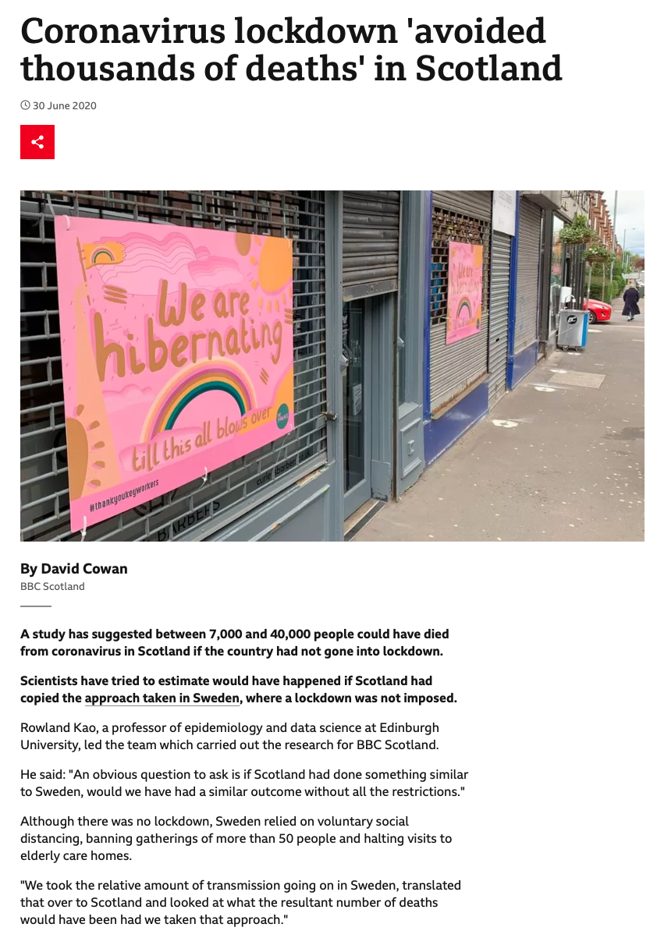
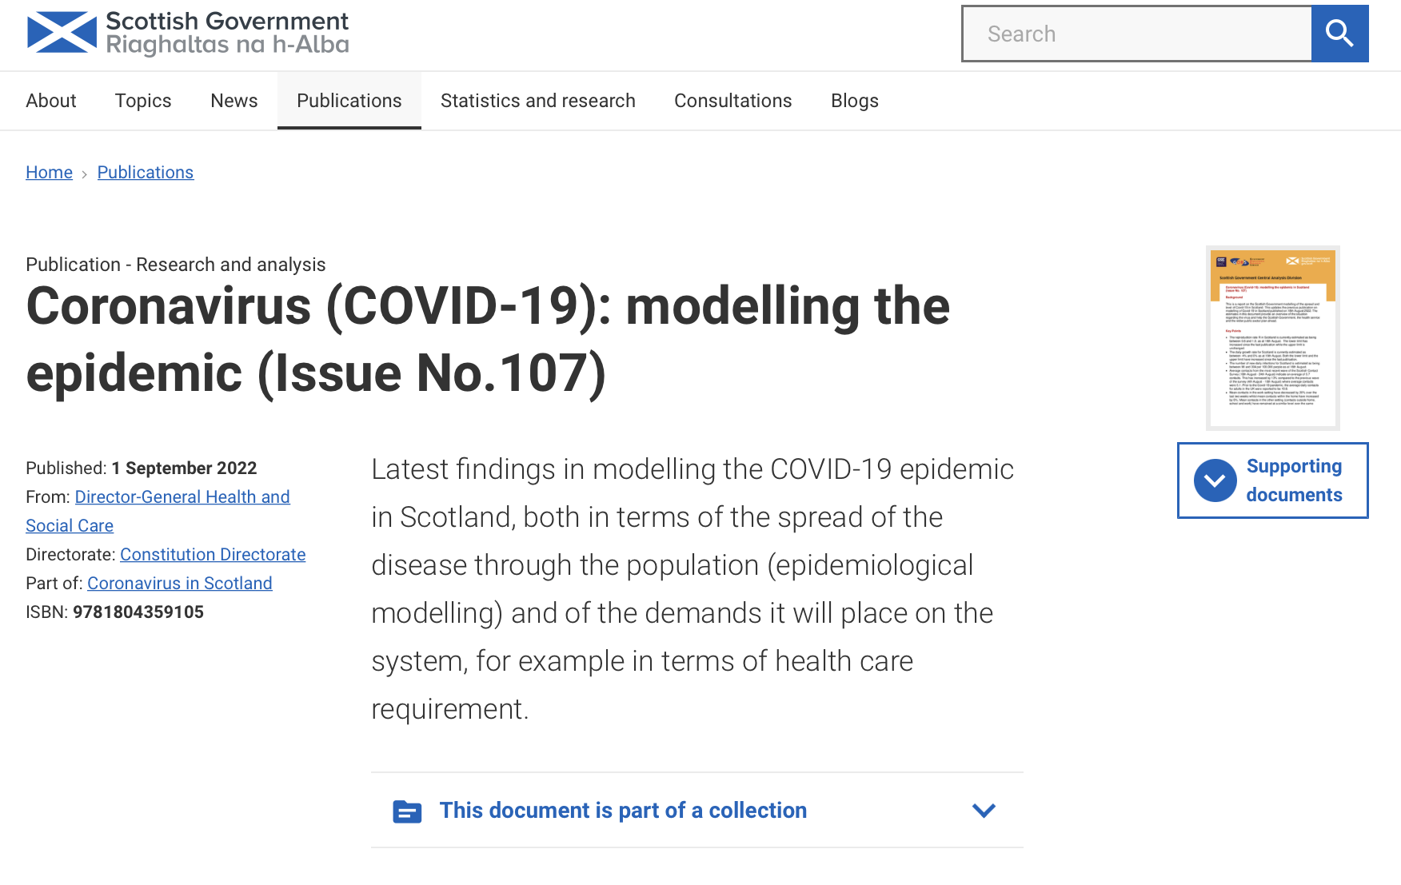
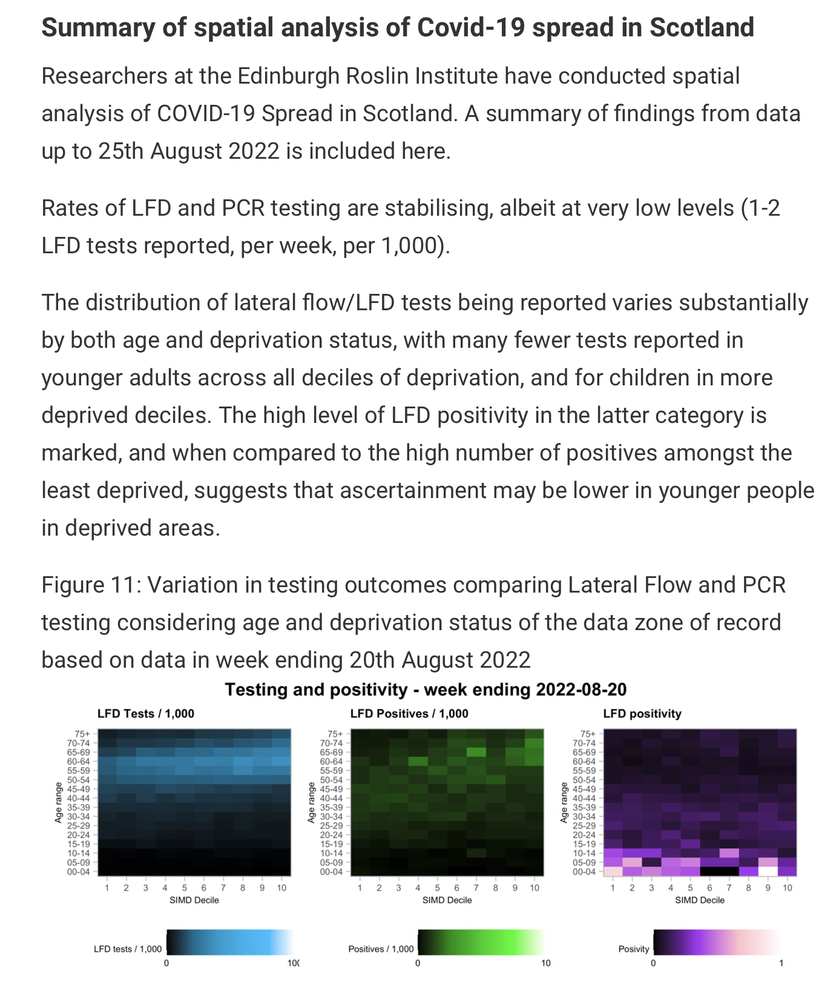

Slide 15
My experience
Notable development in my programming
from smaller, self-contained code to perform simpler tasks
to
“large”, complex scripts that
Are central to work that ends up in peer-review
Require extreme care with storage of data
Have spin-offs with short turnarounds
Essential that the work is reproducible
My process for COVID was good enough, but very manual and caused some headaches later on

Slide 16
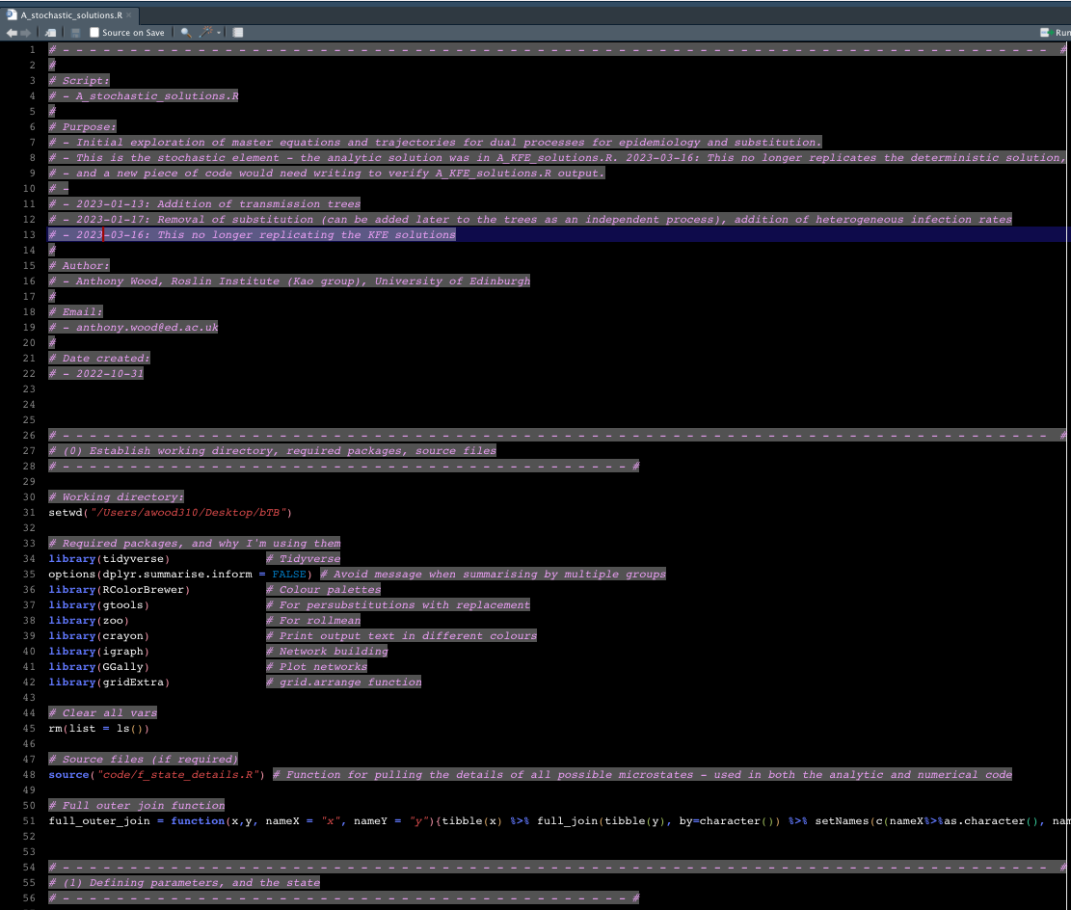
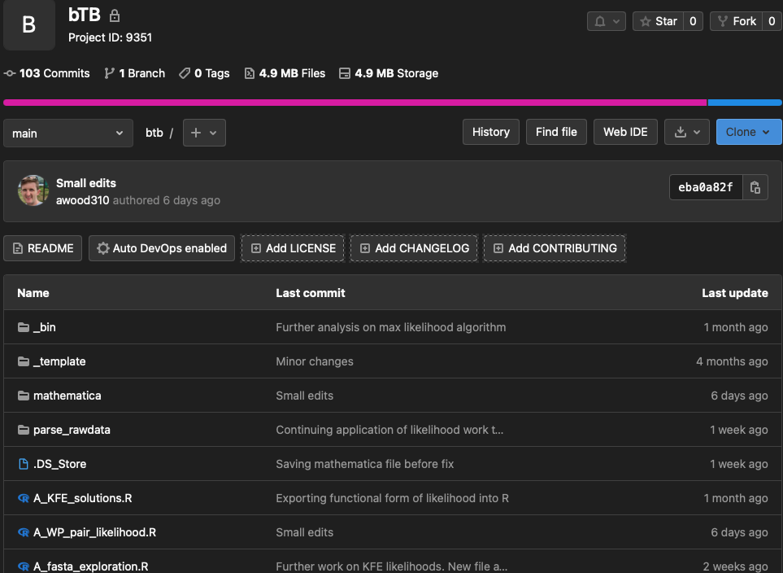
Resolutions
At the start of a new project, take time to set up processes for version control, sharing, standardising of code structure
Essential for my next project: The aim is to develop methods to be used by others!
2-3 days spent at the start of a project learning some basic git commands saves weeks later on!

