Slide 1
Coding from your VLE EDINA, the University of Edinburgh

Slide 2
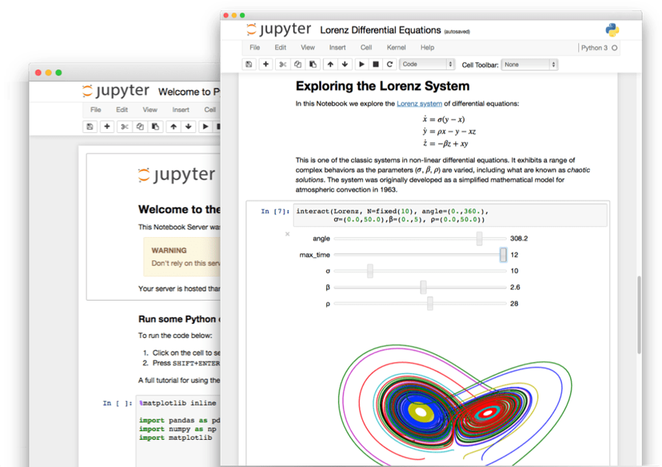
What does Noteable do?
Noteable provides tools and support for lecturers, students and researchers to deliver computational narratives and coded solutions enable built on Jupyter notebooks.
These can be readily created, shared and reused regardless of their level of skill or knowledge.

Slide 3
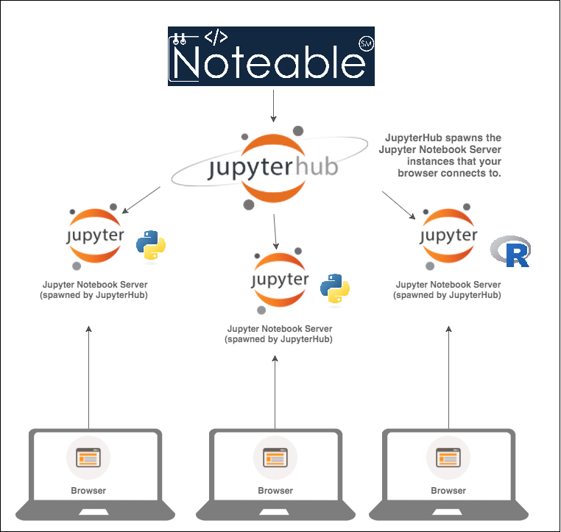
Noteable access
LTI integration with all leading VLEs incl. LEARN
Infrastructure for course assignments, file and identity management
Landing place for significant and meaningful open-source project contributions incl. JupyterLab, Classic, RStudio
Good Data & Digital Literacy – facilitating the bridge

Slide 4
Noteable in application
“Computational notebooks can empower guides for introducing methods to new users and can help researchers reach broader audiences interested in learning from, adapting, and remixing their work. Due to their utility and versatility, the ongoing adoption of computational notebooks in urban planning, analytics, and related geo-computation disciplines should continue into the future.”
- Geoff Boeing, Urban planning and spatial analysis professor at University of Southern California
Jupyter Notebooks are a highly beneficial tool for modern data analysis and for creating reproducible workflows, both for web-based access of large data and its effective manipulation and data visualisation with bokeh or jupyter widgets.
- Julia Wagemann, Co-Founder, Geospatial Women
Abstract Jupyter Notebooks benefit data analysis in multiple ways since data access, manipulation and (interactive) visualisation can be combined in one workflow and programming environment.
- Stephan Siemen, Head of Development Section Forecast Department, European Centre for Medium-Range Weather Forecasts

Slide 5
Noteable for Researchers
Lower barriers to reproducibility
Provides the tools for an effective notebook lifecycle

Slide 6
Accessing Noteable for research
All course members work in same environments, less set up
Able to expand class sizes and be more flexible in where classes held
Easiest way to get started with geospatial modeling and analysis with docker images and example/tutorial Jupyter notebooks
No installation required, access with browser
Managed environment with support from the Universityi’s centre for digital expertise EDINA
Easily switch between containers
We extend the Jupyter Notebook platform to enable users to run interactive notebooks on the cloud resource – accessible online through UoE portal
Noteable Notebooks are ideal for displaying your workflows
Edina@ed.ac.uk +44 (0)131 650 3302

