Slide 1
Digital Research Facilitation Research Services, IT Infrastructure, ISG
Eleni Kotoula
Eleni.Kotoula@ed.ac.uk
Andre Vieira
Andre.Vieira@ed.ac.uk
Sarah Janac
Sarah.Janac@ed.ac.uk

Slide 2
Digital Research Facilitation Remit
We help researchers to get the most out of the research services available to them from Information Services Group and other providers.

Slide 4
https://digitalresearchservices.ed.ac.uk/

Slide 6
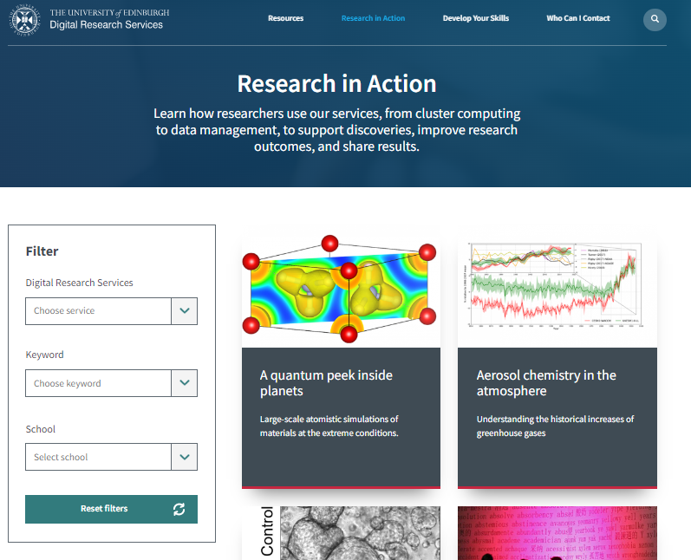
https://digitalresearchservices.ed.ac.uk/research-in-action/

Slide 10
DRS & CERSE
Active participation
Hosting of meetings
Setting up agendas & identifying speakers
Communications (social media, mailing lists, newsletters and more…)

Slide 11
Let’s stay in touch
digitalresearchservices@ed.ac.uk
Contacts
Websites
Social media
https://mlist.is.ed.ac.uk/lists/subscribe/digitalresearch
https://www.digitalresearchservices.ed.ac.uk/
https://www.linkedin.com/company/DRS_UoE
https://twitter.com/DRS_UoE

