Slide 1
Edinburgh Carpentries (EdCarp)

Slide 2
Training - Carpentries
Started by Greg Wilson in North America
The Software Sustainability Institute primary in spreading to UK/Europe
Teach basic computing skills to students/staff
Started with Software Carpentries (software-carpentry.org) then …
Data Carpentry (datacarpentry.org)
Library Carpentry (librarycarpentry.org)
HPC Carpentry – in development (hpc-carpentry.github.io)
etc.
S/W, Data, Library come under “The Carpentries” (carpentries.org)
Type of carpentry emphasizes the subject modules that are taught

Slide 3
So what is taught?
Bash shell (0.5 d)
Git (0.5 d)
Python (1 d)
Intro to data (0.5 d)
Unix shell (0.5 d)
Open Refine (0.5 d)
Intro to git/Python (0.5 d)
Spreadsheets (0.25 d)
Open Refine (0.25 d)
R (1.5 d or 1 d + SQL 0.5 d)
Typically run over 2 days but other scenarios possible
Content is customisable – can swap modules in/out
Focus is on good practice
Can be tailored to specific domains, e.g. ecology, genomics, etc.
Lessons available on-line under a CC-BY licence
Free to use but to call yourself a Carpentry and use infrastructure a fee is involved
Edinburgh University taken out a Gold organizational membership
Notes:
Individual carpentry logos: https://github.com/carpentries/carpentries.org/tree/gh-pages/images/logos
The Carpentries logo: https://github.com/carpentries/carpentries.org/blob/gh-pages/assets/img/TheCarpentries.svg

Slide 4
How is it taught?
Instructor led
Instructor at the front types content on own laptop
Students
Type content on own laptops (most of the time)
End up with a working copy of application/software on own machine
Take away copies of software
Given red/green post-it notes
Helpers
Help students who run into (a) problem(s)
Signal by sticking the red post-it note at the top of the laptop

Slide 5
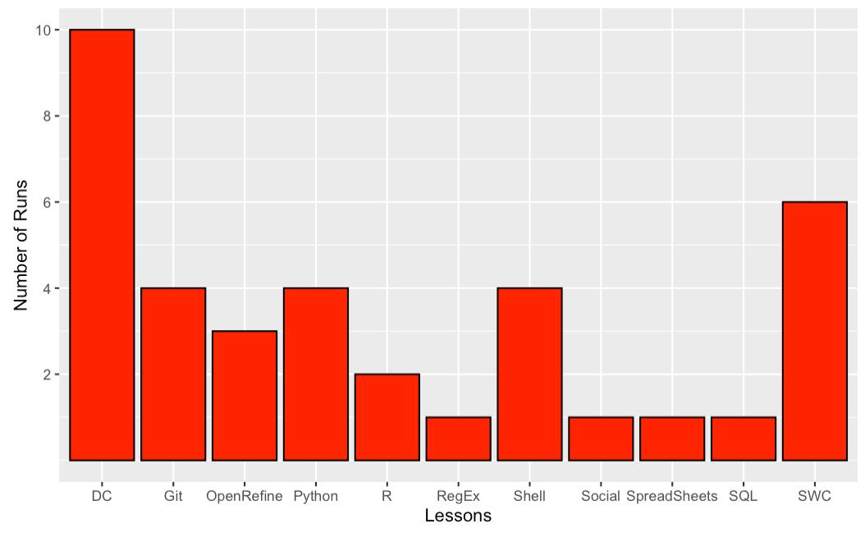
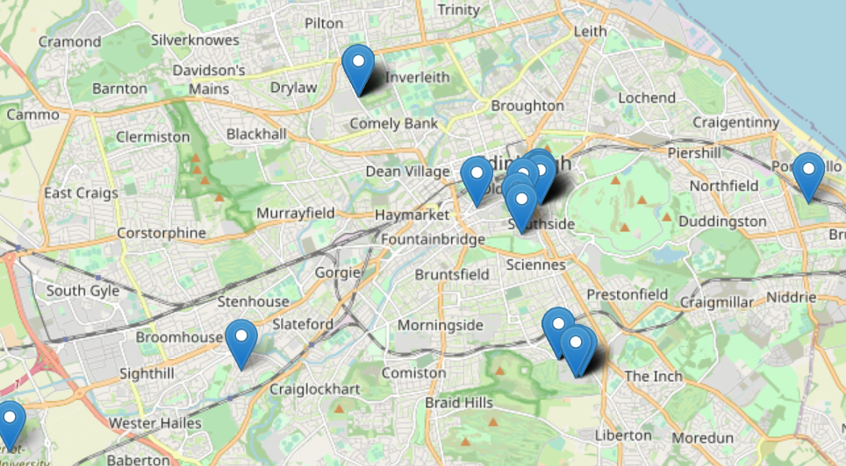
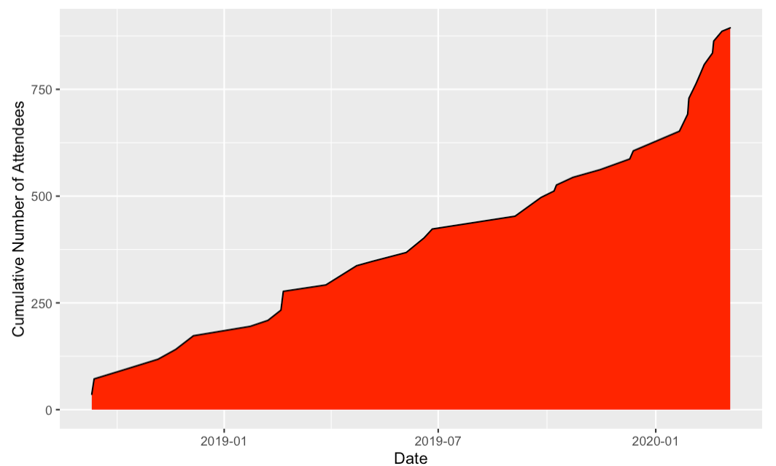
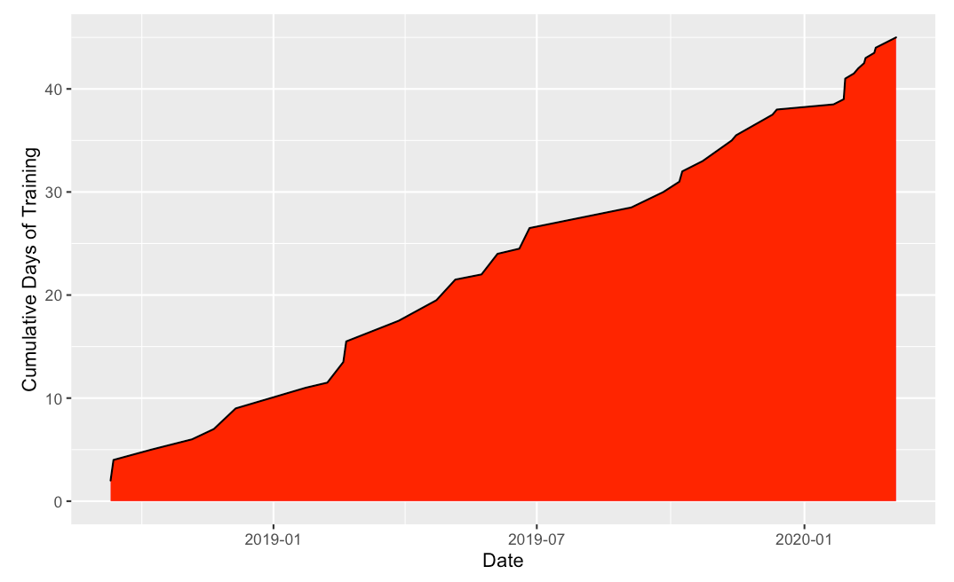
What is EdCarp?
Coordinated approach to teach Carpentries in Edinburgh
Provision of Instructors and helpers
Using a GitHub organizational repository:
https://github.com/edcarp
From Sep 2018 – May 2020
Run about 37 events (45 days of training)
Trained about 894 people (missing some data)

Slide 6
Typical example (in ye olden days)
Software Carpentry at HW on 28/03/2019. Data Carpentry at HW on 26/06/19.

Slide 7
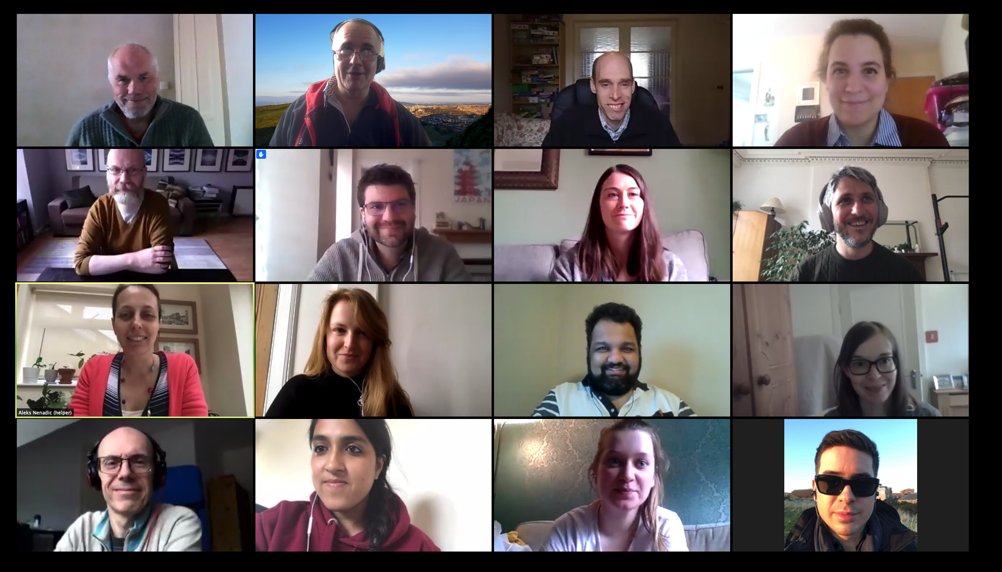
The new norm (for now)
SFC Data Carpentry on 29-30 April 2020 on Zoom.

Slide 8
Why do I want to be involved?
As a learner:
Learn new skills
Go from a learner -> Helper -> Instructor
As a helper (voluntary):
Problem solver/thinking on your feet
Deeper learning
CV material
As an instructor (voluntary):
Even deeper learning to be able to teach
Improve your teaching (feedback)
Formalise (become a certified instructor + extra CV points)
Join an exciting/dynamic community

Slide 9
Find out more
GitHub Org io pages:
https://edcarp.github.io/
Slack channel: edinburghcarpentries.slack.com
Email contact: edcarp@ed.ac.uk
Email list (join): http://eepurl.com/gl4MsX (more for announcements)
If you want to be involved, please get in touch
You could host a Carpentry event
Always on the look-out for Instructors/Helpers
Attendee -> Helper -> Instructor

